Slide 1

Presentation Video URL
{ }

Slide 2

GNUstep Conceptual Architecture
PRESENTED BY
🟩 Daniel – System Functionality • System parts & interaction
🟦Mohamed (Group Leader ) – Evolution • How the system evolves
🟨 David – Control & Data Flow • Data & command flow
🟪 Mirwais – Concurrency • Parallel processes &tasks
🟥 Musdaf – Developer Roles (presenter 1) • Task distribution &
🟥 Mohanad - Use cases and sequence diagrams
(presenter 2)

Slide 3

overview
Introduction: Brief explanation of our topic and goals.
Architecture & Key Libraries: Overview of GNU step’s modular design and core components .
Use Cases: Real-world examples like drag-and-drop and GUI development.
Concurrency & Team Issues: Multi-threading support and open-source collaboration challenges.
Limitations and lessons learned :Challenges faced and their impact on findings. And lessons we have learned
Conclusion: Summary of key points and closing thoughts.

Slide 4
Introduction
This presentation covers GNUstep, an open-source framework for cross-platform software development using Objective-C. We will discuss its architecture, functionality, and use cases, analyze its strengths and limitations, and highlight lessons learned from working with the framework.

Slide 5
Derivation Process: Considered Alternatives
Architectural Style
Design Pattern
Implementation Language
Considered alternative
Considered alternative
Considered alternative
❌ Layered Architecture
❌ Client-Server
❌ C++
chosen
chosen
chosen
✅ Object-Oriented
✅ MVC
✅ Objective-C
Reason: Modular & scalable
Reason: Clear separation of concerns
Reason: OpenStep compatibility

Slide 6

Object-Oriented Architecture
1
Modularity
2
Scalability
Objects are self-contained and independent.
Developers use as much or as little of the API.
3
Two Main Functionalities
Tools and Applications.

Slide 7




Key Libraries
libs-gui
libs-back
libs-base
Handles graphical objects like buttons and windows.
Manages system calls and windowing system communication.
Implements non-graphical aspects of OpenStep.

Slide 8




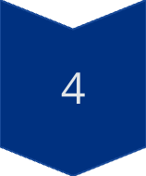
Subsystem Interactions
MVC
Model-View-Controller divides program logic.
Target Action
Objects target each other for actions.
Delegation
One object hands over responsibility.
Message Passing
Programs send messages to processes.

Slide 9

GNUstep Evolution
NeXTSTEP
1
Developed by NeXT, influenced macOS.
2
OpenStep
API specification for multiple platforms.
GNUstep
3
Open-source implementation of OpenStep.
4
Cocoa
Integrated into macOS after Apple acquired NeXT.

Slide 10




Development Roles
Core Developers
1
GUI Developers
Maintain fundamental libraries.
2
Improve application usability.
Bug Fixers
4
Platform Engineers
Maintain reliability and security.
3
Ensure cross-OS compatibility.

Slide 11
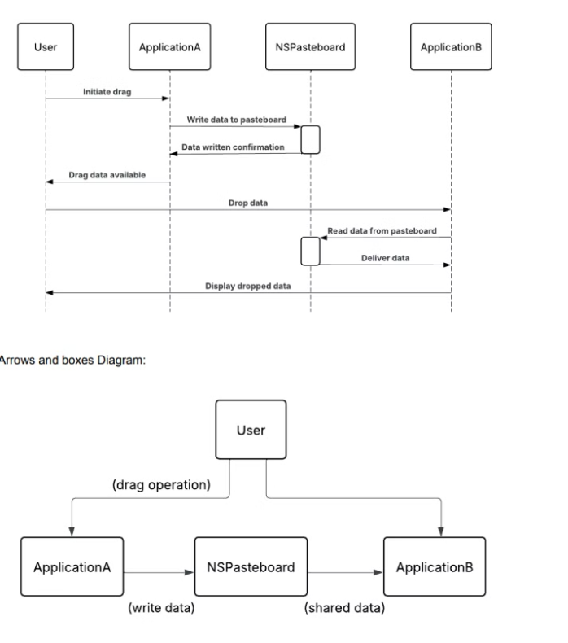
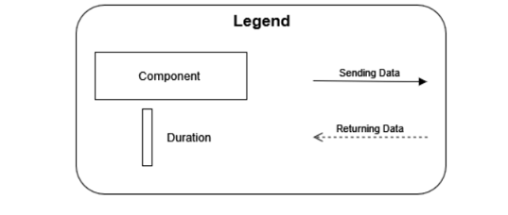
Use Case 1: Drag and Drop Between Applications
A user drags an item (file, image, or text) from Application A to Application B.
NSPasteboard temporarily stores and transfers the data.
Application B retrieves and processes the dropped item.
Ensures smooth inter-application communication in GNUstep.

Slide 12
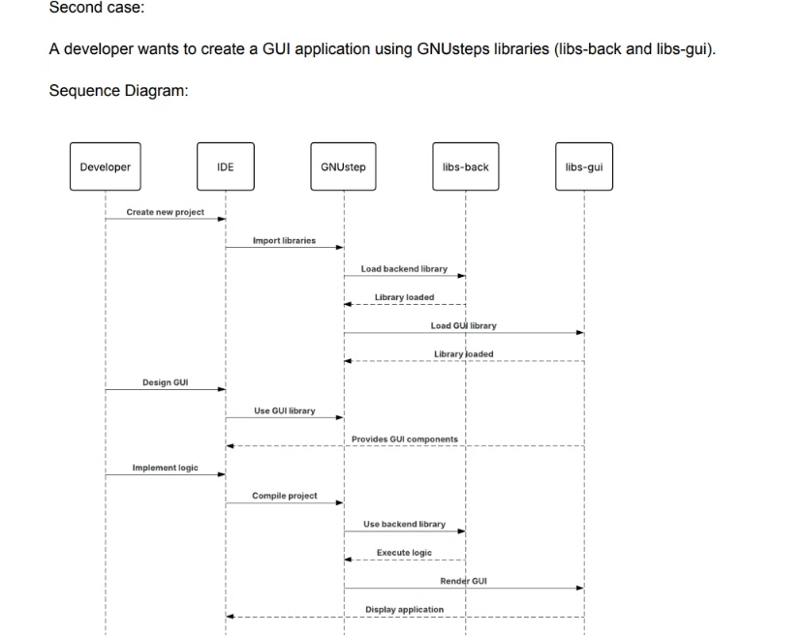
Use Case 2: GUI Development Using GNUstep Libraries
A developer creates a GUI application using libs-gui and libs-back.
libs-gui provides UI elements like buttons and text fields.
libs-back handles system calls and rendering.
Ensures cross-platform compatibility and a consistent user interface.

Slide 13



The effects of concurrency and team issues on the architecture are presented
GNUstep’s modular structure allows independent objects to function separately.
The framework enables parallel task execution through Objective-C.
Contributions depend on community availability, causing delays.

Slide 14
Lessons Learned and Limitations
Lessons Learned
Limitations of Our Findings
Research is Key – Open-source projects need deeper investigation.
Limited Documentation – Some GNUstep details were hard to find
Practice Helps – A hands-on project would improve understanding.
OpenStep vs. Cocoa Confusion – Differentiating them took extra effort.
lear Visuals Matter – Good diagrams simplify complex ideas.
Diagram Challenges – Creating clear sequence diagrams was difficult.

Slide 15

Conclusion
Summarizing the conceptual architecture of GNUstep, the system is designed to support cross-platform software development using Objective-C while maintaining compatibility with the OpenStep API.
The framework is built on a modular and object-oriented architecture, enabling independent components to interact seamlessly through MVC, delegation, and message passing.
Concurrency is handled through multi-threading support, ensuring efficient execution of parallel tasks while maintaining system stability.
Being open-source, development depends on volunteer contributions, which presents both opportunities for innovation and challenges in maintaining consistency and compatibility.
The architecture ensures clear separation of concerns across libraries (libs-gui, libs-back, libs-base) while providing flexibility for GUI and non-GUI applications on multiple platforms.

Slide 16
Refrences
Wikipedia. GNUstep. Retrieved from: https://en.wikipedia.org/wiki/GNUstep GNUstep Official Documentation. Developer Resources. Retrieved from: https://www.gnustep.org/developers/documentation.html Frith-Macdonald, Richard. NSPasteboard. Retrieved from: https://www.gnustep.org/resources/documentation/Developer/Gui/Reference/NSPasteboard.html Christley, Scott, et al. NSApplication. Retrieved from: https://www.gnustep.org/resources/documentation/Developer/Gui/Reference/NSApplication.html GNUstep GitHub Repository. GNUstep Core Libraries. Retrieved from: https://github.com/gnustep Wikipedia. Model–View–Controller. Retrieved from: https://en.wikipedia.org/wiki/Model%E2%80%93view%E2%80%93controller

